Slide 1


CIVIC TECH / RIDER WELFARE
REST
POINT
One live network for safe, nearby rest.
A cross-platform rest and heat-safety app for delivery riders across Abu Dhabi.
FOR
FOCUS
MISSION
Gig workers
Abu Dhabi
Safer shifts
REST POINT
01

Slide 2

THE CHALLENGE
Heat risk rises when rest information stays fragmented
Riders make safety decisions in minutes, often while switching between work apps.
45°C+
Severe heat exposure
Long shifts can extend through peak summer heat.
Many apps
Scattered facility data
Operator-specific information hides nearby public options.
Low visibility
Unused public assets
Cooling hubs and shelters stay invisible to riders.
“Where can I cool down
before the next pickup?”
REST POINT
02

Slide 3


RIDER REALITY
Three behaviors shape the product
The interface must work during short breaks, under pressure, and across languages.
70%+
3–5 min
6
Multi-app work
Decision window
Core languages
A neutral app avoids platform lock-in.
Nearby choices must appear immediately.
Visual cues reduce dependence on text.
REST POINT
03

Slide 4
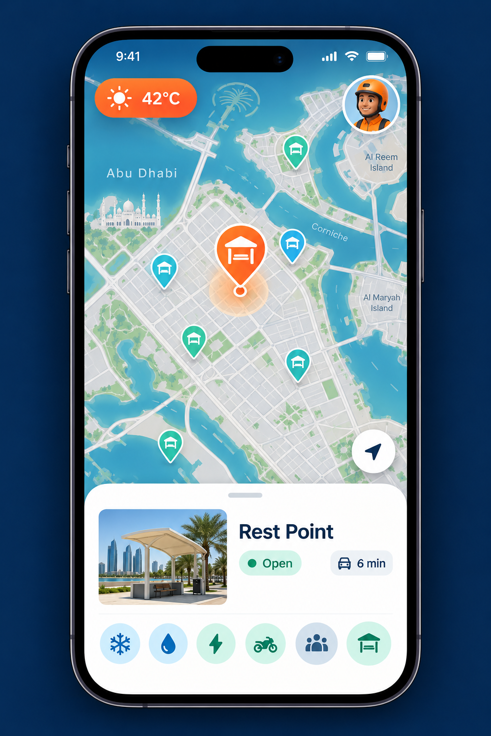
PRODUCT VISION
One map for every safe rest option
Government, public, and commercial locations appear in one rider-first experience.
Neutral by design
Works across every delivery platform.
Live amenity view
AC, water, charging, parking, crowding.
Verified by riders
Fast status reports improve trust.
REST POINT
04

Slide 5
MVP EXPERIENCE
From heat alert to a verified rest stop
A single flow keeps the rider moving while reducing taps and uncertainty.
01
02
03
See nearby
Choose confidently
Rest and report
Map opens around the rider with amenity filters.
Distance, hours, crowding, and facilities stay visible.
One tap confirms status or flags an issue.
Built for one-handed use • high contrast • six-language navigation
REST POINT
05

Slide 6
DATA AND PARTNERSHIPS
A shared network makes existing infrastructure useful
Rest Point connects trusted public data with rider updates and partner locations.
REST
POINT
PUBLIC DATA
REST
POINT
AD Mobility shelters and government rest points
PARTNER PLACES
Fuel stations, malls, kitchens, and rider lounges
MAP
ALERTS
ANALYTICS
RIDER SIGNALS
Crowding, broken amenities, and open status
One reliable data layer for workers, operators, and public agencies
REST POINT
06

Slide 7
SUSTAINABLE MODEL
Free for riders, funded by institutions and partners
Revenue supports coverage, verification, and safer operations without charging workers.
LAUNCH
SCALE
EXTEND
Impact grants
Fleet dashboard
Partner offers
Pilot mapping and rider research
Heat-safety and usage insights
Relevant discounts near rest points
Ma’an / civic innovation
B2B subscription
Sponsored placement
Principle: commercial value comes from safety infrastructure, never rider access.
REST POINT
07

Slide 8
PROACTIVE HEALTH SAFEGUARDS
Heat protection that acts
before a rider feels unwell
When conditions cross the safety threshold, the app finds a nearby cooling option and keeps the route simple.
42°C
6 min
1 tap
Weather threshold
Nearest safe stop
Start navigation
Localized alerts • low-data mode • clear return-to-work guidance
REST POINT
08

Slide 9
EXECUTION
A focused path from pilot to UAE coverage
Each phase adds data depth before geographic expansion.
Q1–Q2
Q3–Q4
YEAR 2
Abu Dhabi pilot
Partner integration
UAE expansion
Rabdan, Shakhbout City, and Khalifa City
ADNOC-style hubs and fleet dashboards
Dubai, Sharjah, and Northern Emirates
Map / verify / learn
Connect / measure
Replicate / localize
REST POINT
09

Slide 10

THE NEXT STEP
Build Abu Dhabi’s
shared rest network.
We are seeking pilot partners, public-data access, and seed support for rider testing.
PILOT WITH US
restpoint.ae
Safer shifts. Better infrastructure use. Dignified rest.
REST POINT
10

Slide 11
APP VISUAL KIT
A reusable identity built for the product
The deck and app share the same character style, palette, and visual cues.
RIDER AVATARS
Profile images, report attribution, onboarding, and multilingual help.
NAVY
ORANGE
CYAN
MINT
#0B1830
#FF6724
#00A4D6
#2BC797
REST POINT
11

Slide 12
PRODUCT DESIGN
Interface rules that survive real-world use
The system prioritizes speed, heat-glare readability, and simple reporting.
1
Large touch targets
2
Color plus labels
Primary actions stay easy to hit with gloves or one hand.
Status never depends on color alone.
3
Essential data first
4
One-tap reports
Distance, open status, and cooling facilities lead.
Riders can flag issues without typing.
Designed for outdoor conditions, short attention windows, and multilingual use.
REST POINT
12

Slide 13
REFERENCES
Image sources and concept-art note
SOURCE PHOTOGRAPHY
yallaabudhabi.ae – “Rest Stops for Delivery Riders in Abu Dhabi”
gccbusinessnews.com – “ITC unveils rest stops for delivery bike riders”
ORIGINAL CONCEPT ART
Rider avatars, product-map mockup, and cooling-station hero were created for this Rest Point concept. Treat the mock map as a design reference, not verified navigation data.
Before production: validate every facility, operating hour, temperature threshold, language translation, and routing result with the responsible authority.
REST POINT
13

